Slide 1


S4D400 - Introduction to abap programming on s/4hana
Anubhav Oberoy

Slide 2

Agenda – Day 2
The ABAP Development Environment
- Introduction to ABAP workbench
- Features of the Environment with ABAP
- Navigation to objects
- Create first ABAP Program
- Understanding the execution of program
---Break---
Elementary ABAP
- Defining literals and Variables
- Field String and Tables Statement
- Types and Likes in ABAP
- Constants
- Working with If conditions, case expression
- Looping
- System variables sy-index, sy-tabix
- Exit, Continue and Check statements
- Debugging

Slide 3
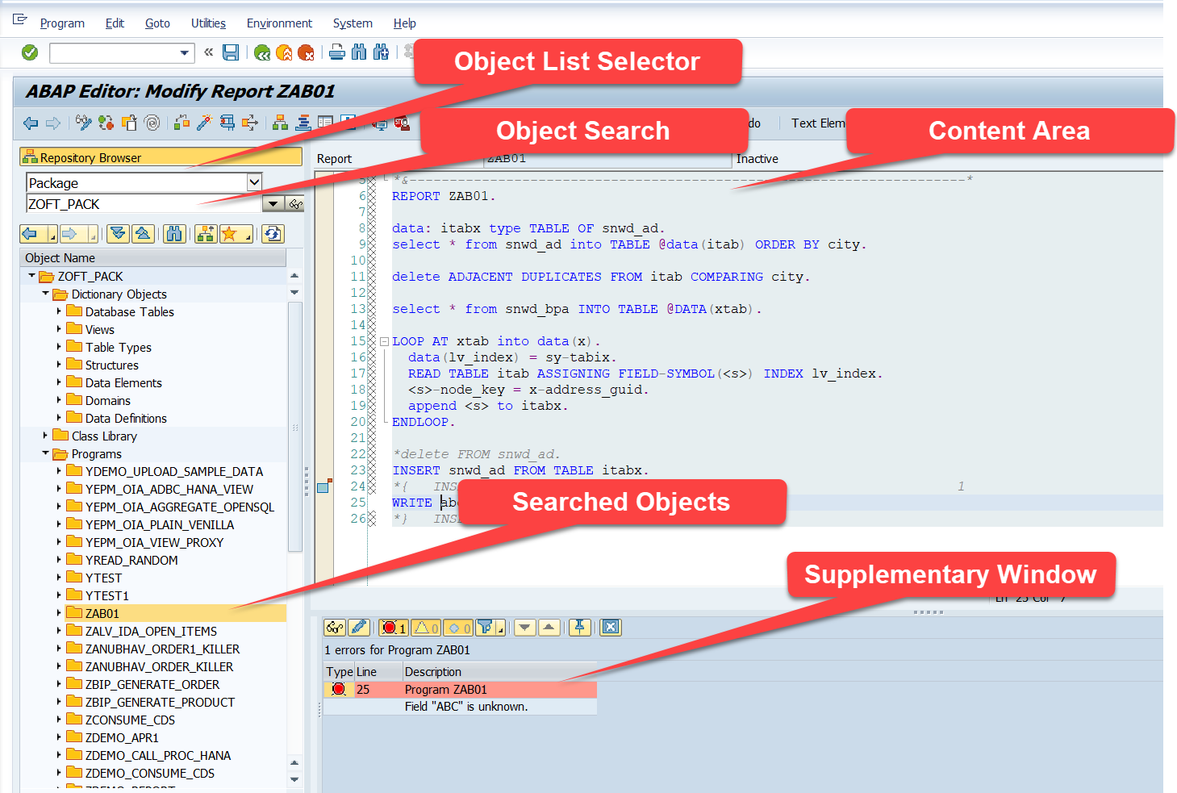
Introduction to ABAP Workbench

Slide 4
Exercise – get used to SE80
Search the database table created in last section. Try to edit data element created in last class.

Slide 5
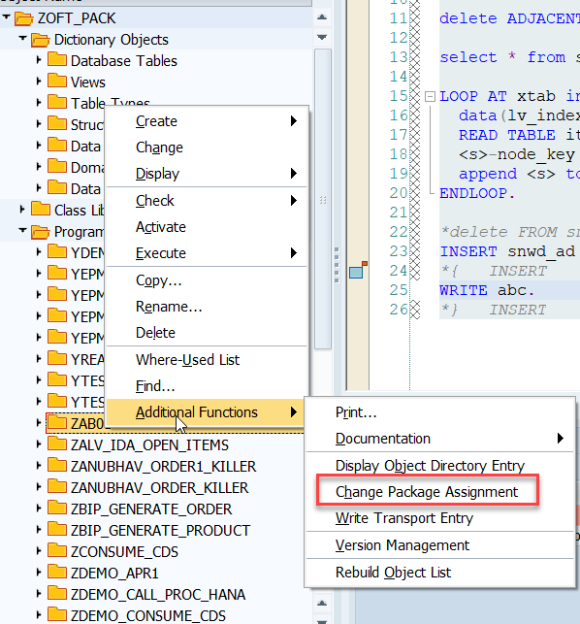
Package Assignment

Slide 6
Exercise – Change Packages
Create a simple structure for admin info in local object and move that to your productive package.

Slide 7
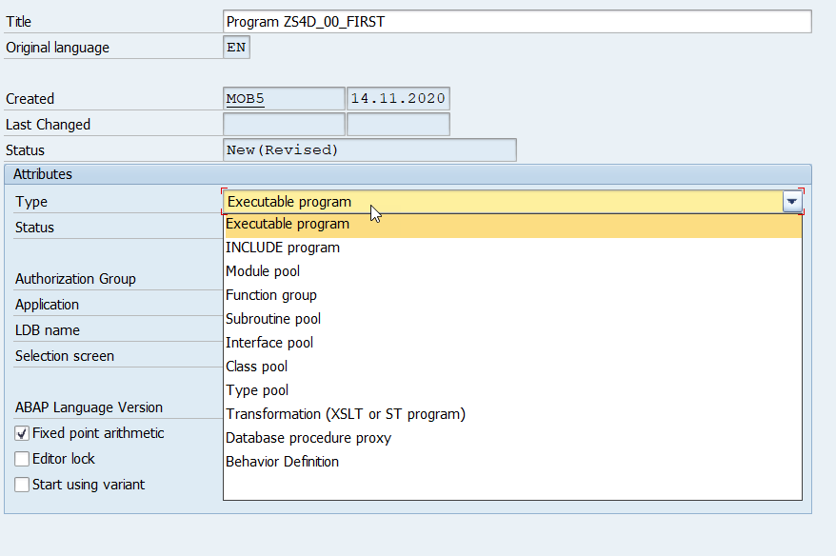
Types of ABAP Programs

Slide 8
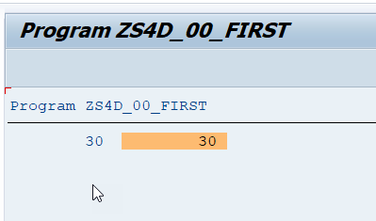
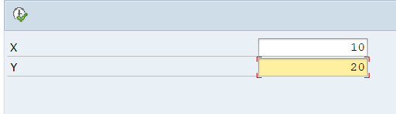
Exercise - Write Your First ABAP Program
Write below ABAP programs – ZNC_XX_FIRST
Create Hello World program
Create program to add two numbers
Create Parameters to pass value
Format the output

Slide 9
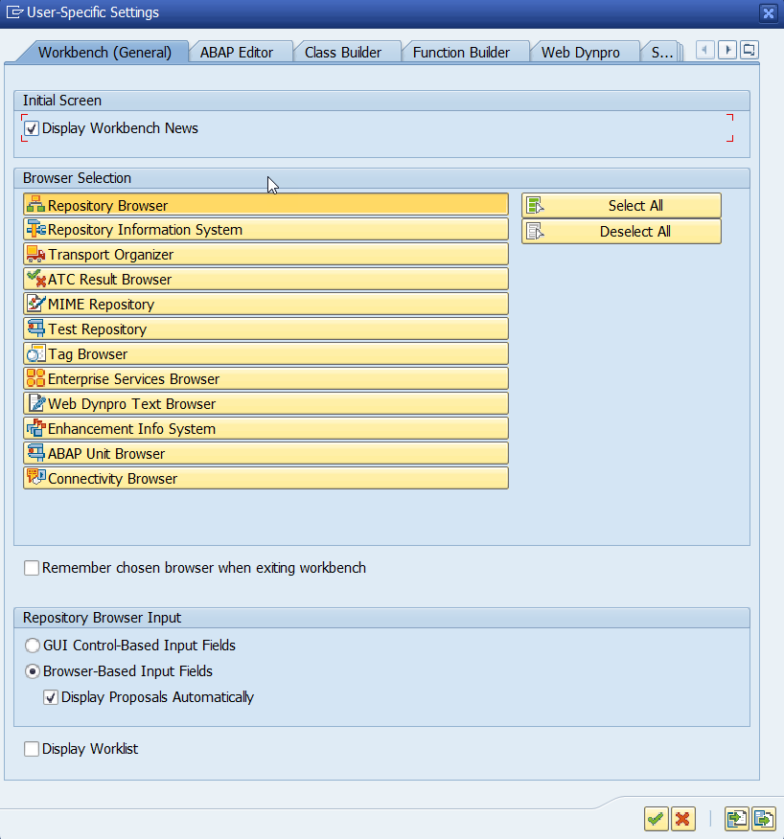
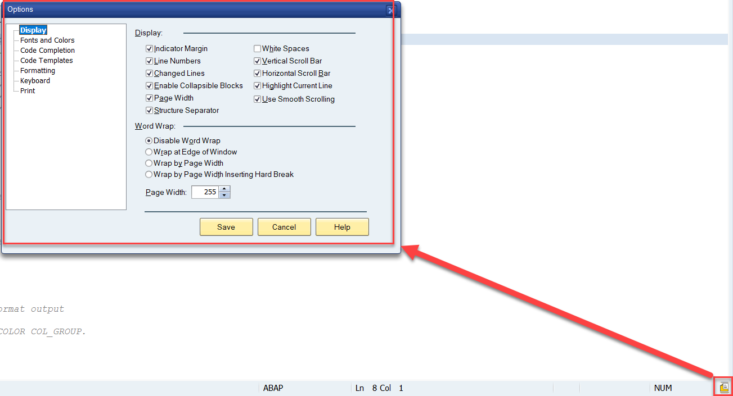
Workbench options & code Completion

Slide 10
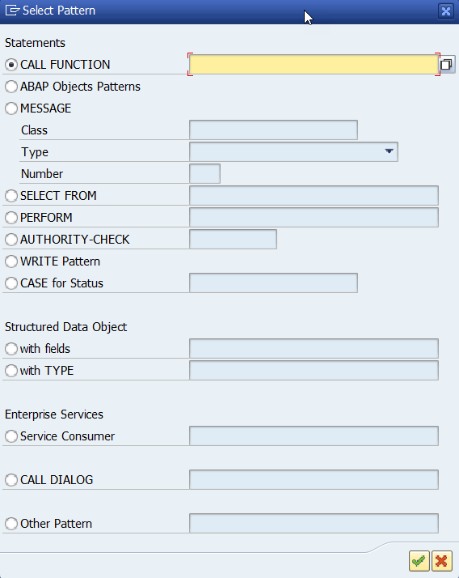
Pattern Window

Slide 11
Exercise – pretty printer
Format our code using pretty printer.

Slide 12
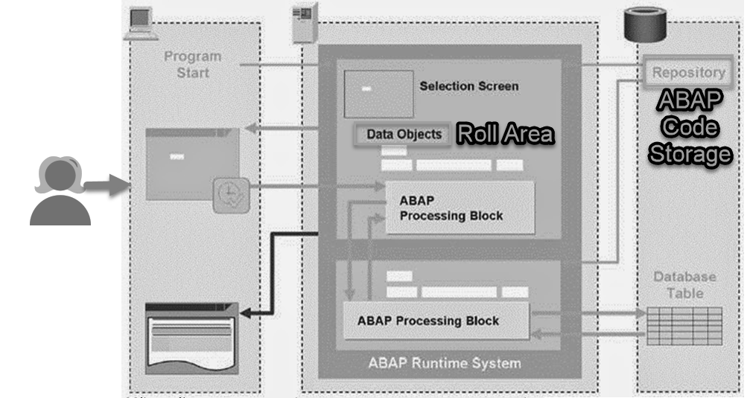
What is happening under the hood
Notes:
Processing of the report is as follows:
1. Enter the input (Presentation layer)
2. Validate the input for correction (Processing program)
3. Call the function module that returns the detail of the material number. (This function module reads the data from the database table) (Resuable program)
4. Return the output to the processing program.
5. The processing program displays the result to the in the output screen through presentation layer.
Step 1: Start of the program. After logging into the screen, a user can select any of the requested application by calling the transaction code or by using menu path.
Example: User runs the report.
Step 2:The runtime system loads the program context in the memory from repository. Program context contains selections screens and variable declared in the program are allocated with memory to hold inputs.
Example: The systems reads the report and created necessary data objects for execution.
Step 3: The runtime system sends the selection screen to the presentation server. The presentation server holds the control as long as the user enters the input and executes further.
Example: The selection screen is presented to the user for input(material number).
Step 4: The user enters the input and triggers the further execution. The entered data is then automaitcally placed in the corresponding memory location created for them. Then the runtime system resumes the process for further processing the information.
Example: The user input(material number) is stored in the memory
Step 5: In our example there is only one processing block. If the program calls for another reusable units such as function modules are class etc then the reusable unit is also loaded from the repository into the runtime. The processing block that calls the reusable unit wait until the execution of reusable unit is complete and then resumes the opeartaion.
Example: The ABAP program validates the material number and then call the function module(Reusable unit) to get the details of the material by passing the material number. Till the time the function module completes its execution, the processing program waits.
Step 6: If the reusable unit, reads any data that is stored in the database, then the connection is made to the database layer to access the data.
Example: The reusable unit(Function module) reads the data from the database table. For which a connection made to the database layer to get the data(Material details).
Step 7: The database layer returns the value to the reusable unit.
Example: The database layer reads the material table and returns the material table to the requested program, which is function module in our case.
Step 8: Then when the reusable unit completes its execution, the program that called the reusable unit is resumed.
Example: The function module after completing its execution returns the data to the program that called the function module, which is report in our case.
Step 9: The runtime system sends the output to the Presentation layer after its processing is complete.
Example: The report completes its execution and transfer the data to the presentaion layer to be displayed as output.

Slide 13

Data Objects in ABAP
Data objects are memory locations that you use to hold data while the program is running. There are two types of data objects: modifiable and non-modifiable. The types of non-modifiable data objects are literals and constants. The modifiable data objects are variables, field strings, and internal tables. A field string is the ABAP/4 equivalent of a structure. An internal table is the ABAP/4 equivalent of an array.
Data objects have three levels of visibility: local, global, and external. The visibility of a data object indicates from where in the program the data object is accessible.
A literal is a non-modifiable data object. Literals can appear anywhere in a program, and they are defined merely by typing them where needed. There are four types: character string, numeric, floating-point, and hexadecimal.
Character String Literals : 'Hello SAP world'
Numeric Literals : They are not usually enclosed in quotes. However, if a numeric literal contains a decimal, it must be coded as a character string enclosed within single quotes. '10.5’
Floating-Point Literals '<mantissa>E<exponent>' '9.99E9’
Hexadecimal Literals : A hexadecimal literal is specified within single quotes as if it were a character string. The permissible values are 0-9 and A-F. There must be an even number of characters in the string, and all characters must be in uppercase. Examples of valid hexadecimal literals are '00', 'A2E5', and 'F1F0FF'.

Slide 14
Defining Variables
Two statements are commonly used to define variables in an ABAP/4 program:
1. data
data v1[(l)] [type t] [ like <udv> ][decimals d] [value 'x’].
Notes:
SAP recommends that variable names should always begin with a character and they should not contain a dash. A dash has special meaning
Do not use USING or CHANGING as variable names. Although they are syntactically correct, they can cause problems if you try to pass them to subroutines
It is good programming practice to place all data definitions together at the top of your program before the first executable statement.
Character Data Types : c(65535), n, d(8 fix), t(6 fix), x
Numeric Data Types : I, p, f
2. parameters
parameters p1 like v1 ... ... [default 'xxx'] [obligatory] [lower case] [as checkbox] [radiobutton group g].
Notes:
There are two variations of the parameters statement: parameter and parameters. Operationally, there is no difference between the two; they are completely interchangeable.

Slide 15
System Variable
A system variable hold a particular value at some point of time to help application to take decision or provide information.
For e.g. sy-datum provide current date. All the system variables are part of SYST table.

Slide 16
Exercise – Data Objects Declaration
Create program with simple Data objects, System variables and Parameters.
Program Name: ZNC_XX_DATAOBJ

Slide 17

Break

Slide 18
Difference between Like and Type
Q1. What is difference between DATA and TYPES?
Ans. Data allocates the memory but TYPES is used to declare the user defined data types.
Q2. What is difference between TYPE and LIKE?
Ans. Use TYPE when you define variable using standard, user defined or standard data type. Use LIKE when you define variables using another variable within same program.

Slide 19
Defining Constants
A constant is almost identical to a variable except that its value cannot be changed. To define one, you use the constants statement.
Use a constant when you need to include the same literal multiple times in a program. You can define a constant with the same value as the literal and use the constant in the body of the program in place of the literal. Later, if you need to change the value of the literal, you can simply change the value of the constant, causing its value to be updated wherever it is used in the program.
Syntax:
constants c1[(l)] [type t] [decimals d] value 'xxx'.

Slide 20
Exercise – Constant and LIKE/TYPE
Create ABAP program to add constant along with like and type
Program Name: ZNC_XX_CTYPE

Slide 21
Field Strings
A field string is a type of variable, and is the equivalent of a structure in the DDIC but is defined within an ABAP/4 program. Like a structure, a field string is a series of fields grouped together under a common name. The difference lies mainly in where the definition resides. The term structure in R/3 applies only to a Data Dictionary object containing a collection of fields. The term field string applies to a collection of fields defined in an ABAP/4 program.
Two statements are usually used to define field strings in an ABAP/4 program:
data
Tables

Slide 22
Define using Data
The following is the syntax for defining a field string using the data statement.
data: begin of fs1,
f1[(l)] [type t] [decimals d] [value 'xxx'],
f2[(l)] [type t] [decimals d] [value 'xxx'],
...
end of fs1.
or
data begin of fs1.
data f1[(l)] [type t] [decimals d] [value 'xxx'].
data f2[(l)] [type t] [decimals d] [value 'xxx'].
...
[include structure st1.]
data end of fs1.
or
data fs1 like fs2.
fs1
F1 | F2 | <include> | ….
st1
FF1 | FF2 | … | ….

Slide 23
Field String Defined Using TABLES
A field string defined using the tables statement is a modifiable data object. Field strings defined using the tables statement follow the same rules as field strings defined using the data statement.
A field string defined using tables always has both global and external visibility no matter where it is defined in the program. This means that if you place a tables statement in a subroutine, the definition is global and you cannot have another definition for the same field string anywhere in that program.
The following is the syntax for defining a field string using the tables statement.
tables fs1.

Slide 24
Exercise – Field String
Define field string using multiple syntax options and ways
Program: ZNC_XX_FIELDSTRING
Why do I need to create field strings? Why can't I use just simple variables?
Field strings give you a way of organizing your variables into groups. When you have hundreds of variables in a program, organizing them into field strings makes the relationships between the variables clearer. Using field strings to group fields together also enables you to perform an operation on a group of variables as if they were a single variable. So, for example, if you need to move 100 variables, you can usually code a single statement to perform the move from one field string to another, instead of coding 100 assignment statements for individual variables. Moving a single field string is also more efficient than 100 move statements, so your program runs faster. You will see in the coming chapters that many statements can use a field string as an operand. If you can use field strings, you can take advantage of them, and they will save you a lot of coding and debugging time.
Why would I use my own structured type instead of a DDIC structure? Can't I create field strings with both?
Yes, you can. The functionality of DDIC structures far outweighs that provided by structured types because they can provide labels, F1, and F4 help. However, types can be used to define nested structured types that contain internal tables. DDIC structures can't.

Slide 25
Defining Types
Syntax:
types t1[(l)] [type t] [decimals d].
Think of a user-defined type as a variable, but one that you can't use to store data. It can only be used to create other variables. The same rules apply to types as apply to variables and field strings.

Slide 26
Exercise – User Defined Types
Define Types and Structured types along with Type-pools in data dictionary.
Program: ZNC_XX_TYPES
Type-pools: ZTX1

Slide 27
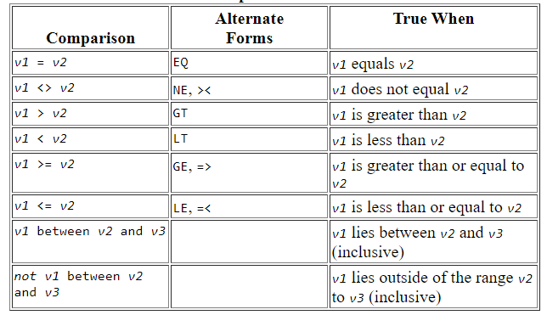
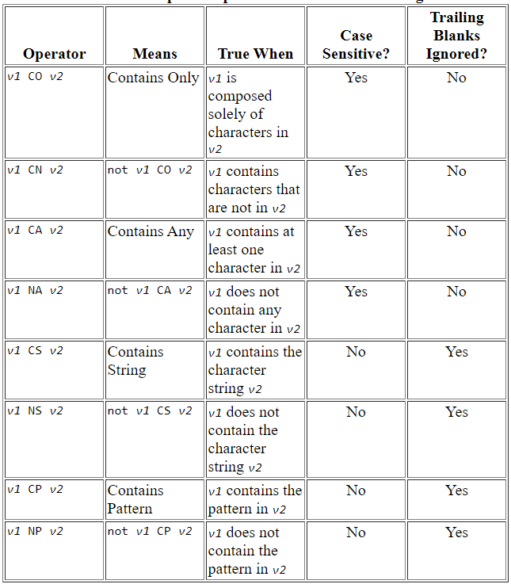
If Statement
The if statement in ABAP/4 has relational operators for equality and inequality and special relational operators for string comparisons and for bit masks.

Slide 28
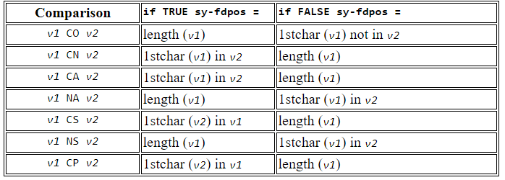

Sy-fdpos variable
Use of these operators always sets the system variable sy-fdpos. If the result of the comparison is true, sy-fdpos contains the zero-based offset of the first matching or non-matching character. Otherwise, sy-fdpos contains the length of v1. The value assigned to sy-fdpos by each operator is described in Table

Slide 29
Exercise – If Conditions
Exercise for the If Condition with simple and string comparison operators.
Program Name: ZNC_XX_IF

Slide 30
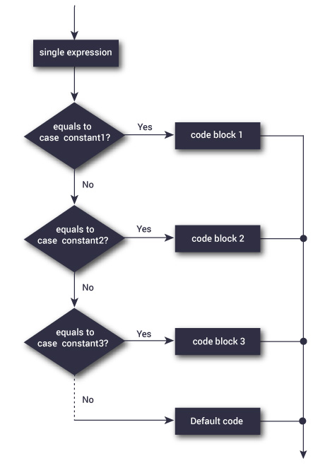
Case Expression
The case statement performs a series of comparisons. The following is the syntax for the case statement.
case v1.
when v2 [ or vn ... ].
---
when v3 [ or vn ... ].
---
[ when others.
--- ]
endcase.
Only statements following the first matching when are executed.
when others matches if none of the preceding when match.
If when others is not coded and none of the when match, processing continues with the first
statement following endcase.
Expressions are not allowed.
Field strings are treated as type c variables.
Case is very similar to if/elseif. The only difference is that on each if/elseif, you can specify a complex expression. With case, you can specify only a single value to be compared, and values are always compared for equality.

Slide 31

DO Loop
Loops are used to perform repetitive tasks. The do statement is a basic loop mechanism.
The following is the syntax for the do statement.
do [ v1 times ] [ varying f1 from s-c1 next s-c2 [ varying f2 from s2-c1 next s2-c2 ... ] ].
---
[exit.]
---
enddo.
The following points apply:
do loops can be nested an unlimited number of times.
exit prevents further loop processing and exits immediately out of the current loop. It does not terminate the program when inside of a do loop. Processing continues at the next executable statement after the enddo.
You can create an infinite loop by coding do without any additions. In that situation, use exit within the loop to terminate loop processing.
Modifying the value of v1 within the loop does not affect loop processing.
Within the loop, sy-index contains the current iteration number. For example, the first time through the loop, sy-index will be 1. The second time through, sy-index will be 2, and so on. After enddo, sy-index contains the value it had before entering the loop. With nested do loops, sy-index contains the iteration number of the loop in which it is used

Slide 32
Exercise – DO Loop
Understand the DO..EndDO loop for fixed looping times. Use the system variables inside of the loop.
Also use the sy-index system variable to understand the loop counter.
Program Name: ZNC_XX_DO

Slide 33
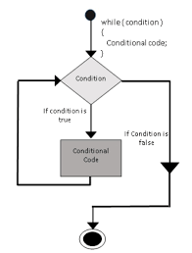
While Loop – a conditional looping
The while statement is a looping mechanism similar to do. The following is the syntax for the while statement.
while exp [ vary f1 from s-c1 next s-c2 [ vary f2 from s2-c1 next s2-c2 ... ]
---
[ exit. ]
---
endwhile.
where:
exp is a logical expression.
s is a field string having the components c1 and c2.
f1 is a variable. The components of s must be able to be converted to the data type and length of f1.
... represents any number of complete vary clauses.
--- represents any number of lines of code.
The following points apply:
while loops can be nested an infinite number of times and also be nested within any other type of loop.
exit prevents further loop processing and exits immediately out of the current loop. Processing continues at the next executable statement after endwhile.
Within the loop, sy-index contains the current iteration number. After endwhile,
sy-index contains the value it had before entering the loop. With nested while loops, sy-index contains the iteration number of the loop in which it is used.
endwhile always copies the value of f1 back into the sending component.
On a while statement containing a logical expression and a varying addition, the logical expression is evaluated first.

Slide 34
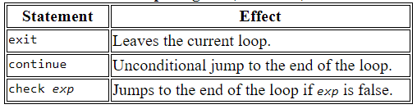
Use of continue, exit and check
The continue, exit and check statements are used to control the flow of the loop and perhaps allows to also jump, come out of the loop depending on need.

Slide 35
Exercise – While and Conditional
Exercise demonstrates the while loop and termination/jump of loop processing depending on the special control flow.
Program Name: ZNC_XX_WHILEC

Slide 36
Debugging
Debugging abap code Basics.

Slide 37
End of Day 2

Slide 38

Questions

Slide 39

Anubhav Oberoy

